Slide 1



Net-Tech Solutions
MODERNIZATION OF COLLEGE NETWORK
PRESENTED TO
Technical Collage Gampaha
UPGRDADING THE FULL NETWORK
PRESENTED BY
Crew of Networking at Net Tech Solutions
09/07/2025

Slide 2
Introduction
Gampaha Technical College is advancing its digital infrastructure by upgrading its network. This proposal addresses current issues such as slow speeds, limited coverage, and outdated systems. The upgrade ensures improved performance, secure access, and support for future academic demands.
College Overview
Gampaha Technical College is a leading institution offering vocational education. It supports students and staff with modern facilities. A reliable network is vital for online learning, admin tasks, and digital development.
The project aims to provide faster connectivity, enhance network security, and ensure reliable access for students, staff, and administrative services through a modern, scalable solution.

Slide 3

About us
OUR TEAM
Our team is composed of skilled members working together to deliver a successful network upgrade. Piyusha Akash leads the group with expert coordination and guidance. The team includes Minura Himasha, Amanda Hansani, Isumi Anujana, and Nethmi Divyanjali.
2025 STARTUP
Founded in 2025, this company aims to deliver innovative solutions in the technology sector. With a focus on growth and quality, it quickly built a strong team and a vision for the future.

Slide 4

Agenda
Overview
Current Network Issues
Goals & Objectives
Proposed Solution
Network Design
Hardware \Software Requirements
Cyber Security & Data Protection
Budget Estimation
Timeline
Benefits
Q&A

Slide 5
Overview
This project focuses on upgrading and modernizing the entire network infrastructure of Technical College Gampaha. The current system is plagued by multiple technical issues, including outdated hardware components, legacy software that no longer receives updates or support, unplugged or poorly laid cabling that disrupts connectivity, and limited Wi-Fi coverage throughout the campus. These challenges have significantly affected the performance, reliability, and security of the college's IT services.
With the growing reliance on digital platforms for education, administration, and communication, there is an urgent need for a high-speed, stable, and secure network. The proposed upgrade will introduce modern networking equipment such as smart switches, structured cabling, wireless access points, and VLAN segmentation to ensure optimized traffic flow, improved security, and better bandwidth distribution.
The ultimate goal of this project is to build a robust, scalable, and future-ready network that can support the increasing demands of students, educators, and administrative staff, while ensuring minimal downtime and ease of management.

Slide 6
Current Issues Identified:
Outdated software: Legacy operating systems and unsupported applications pose security and performance risks.
Old networking components: Aging switches, routers, and access points reduce reliability and scalability.
Disconnected cables and improper topology: Poorly maintained and unplugged cables lead to
unstable connections and downtime.
Lack of central management and monitoring tools: No visibility over network performance or device health.
Limited Wi-Fi coverage: Weak or no wireless access in classrooms and labs.
Security vulnerabilities: No firewall or updated antivirus systems for endpoint protection.

Slide 7
The current network infrastructure at Technical College Gampaha presents several critical issues and limitations that hinder the effectiveness, security, and scalability of digital learning and administrative operations.
1. Outdated Network Components Most networking hardware in use is obsolete. Devices such as switches, routers, and hubs are aged and fail to meet modern performance or reliability standards. This results in frequent disconnections, network lags, and limited throughput. Many systems still rely on legacy connections, and the absence of proper firmware or software updates exposes them to vulnerabilities.
2. Poor Cabling Infrastructure The physical cabling system across the campus is in disrepair. Many Ethernet cables (likely CAT5) are unplugged, damaged, or routed improperly. Cable management is nearly non-existent in some labs, which increases the risk of disconnections and accidents. A lack of labeling further complicates troubleshooting and maintenance.
3. Limited Network Segmentation Currently, all devices seem to exist on a flat network topology, without VLANs or logical segmentation. This causes performance bottlenecks and significantly increases the attack surface, as any compromised machine could potentially reach all other devices on the network.
4. No Wireless Connectivity in Key Areas While Wi-Fi is not a priority in all areas, the absence of even basic wireless access points in staff or shared zones limits mobility and access to cloud-based or collaborative platforms. Instructors and administrative staff are forced to rely on fixed-line PCs, restricting flexibility.
5. Server Room Limitations Although there is a central server room, it lacks proper ventilation, structured racks, and power backup systems. The servers are aging and may not meet the hardware requirements for virtualization, centralized authentication, or backup systems, limiting future scalability.
6. Lack of Monitoring and Management Tools There is no centralized system in place for monitoring, logging, or controlling the network. Issues often go unnoticed until users report them. Without proper visibility, proactive troubleshooting and capacity planning are impossible.
7. Software Compatibility Issues Many desktops in the labs are still running outdated operating systems and applications, which are no longer supported by vendors. This limits compatibility with modern tools and exposes systems to critical vulnerabilities and performance issues.

Slide 8




Goals & Objectives
Improve Network Performance
Increase data transfer speed and reduce latency across all departments.
Enhance Network Security
Implement firewall protection, VLAN segmentation, and endpoint security to safeguard digital assets.
Upgrade Hardware & Infrastructure
Replace outdated switches, routers, and cabling with modern, reliable components.
Ensure Wi-Fi Accessibility
Provide consistent and high-speed wireless coverage throughout classrooms, labs, and administrative offices.
Enable Centralized Network Management
Introduce monitoring tools for real-time visibility, device health, and simplified troubleshooting.
Support Scalability for Future Growth
Design a network that can be easily expanded as the institution grows in users, devices, and digital services.
Reduce Downtime & Maintenance Complexity
Implement a stable and well-documented network layout that minimizes disruptions and simplifies maintenance tasks.

Slide 9
Proposed Solutions
Replace Outdated Network Components
Deploy smart or managed switches with VLAN support.
Install modern routers and wireless access points that support higher throughput and security protocols
(WPA3, etc.).
Decommission legacy hubs and outdated hardware.
Ensure all devices receive firmware updates and are vendor-supported.
Redesign and Upgrade Cabling Infrastructure
Replace all damaged or unplugged CAT5 cables with CAT6 for higher bandwidth and reduced signal loss.
Implement structured cabling systems with proper routing and cable trays.
Label all cables clearly for easier maintenance and future troubleshooting.
Follow proper topology standards to reduce collisions and loops.

Slide 10
Proposed Solutions
Implement VLAN-Based Network Segmentation
Design logical separation using VLANs:
VLAN 10: Admin & Staff Network
VLAN 20: Student Network
VLAN 30: Server Network (optional for scalability)
Apply inter-VLAN routing policies for better security and traffic control.
Reduce broadcast domains to improve network efficiency and isolate threats.
Install Campus-Wide Wireless Access Points
Deploy enterprise-grade wireless access points in classrooms, labs, and staff areas.
Use dual-band (2.4GHz & 5GHz) for device compatibility and reduced congestion.
Secure Wi-Fi using WPA3 encryption and hidden SSIDs for administrative zones.
Create separate SSIDs for guests, students, and staff.

Slide 11
Proposed Solutions
Modernize the Server Room Infrastructure
Introduce network racks, structured patch panels, and UPS backup systems.
Improve ventilation and cooling to prevent thermal shutdowns or hardware failure.
Replace old servers with virtualization-ready hardware (e.g., for file sharing, DNS, DHCP, authentication).
Implement centralized backup and disaster recovery solutions.
Implement Centralized Monitoring & Management
Use tools like Zabbix, Nagios, or PRTG for live monitoring of devices and traffic.
Configure SNMP, Syslog, and alerts for critical events.
Set up a basic NMS (Network Management System) for visibility and control.
Log and track device health, uptime, and usage statistics for proactive maintenance.

Slide 12
Proposed Solutions
Update Software Systems and Endpoints
Upgrade all lab PCs and staff desktops to modern, vendor-supported operating systems (e.g., Windows 10/11, Linux LTS).
Uninstall unsupported applications and replace with up-to-date, secure alternatives.
Standardize software installations across departments using centralized deployment tools (e.g., Microsoft Intune or Clonezilla).
Enhance Network Security
Deploy a firewall at the network gateway (hardware-based or open-source like pfSense).
Install endpoint protection (antivirus/EDR) on all systems.
Enable access control via switch port security and MAC filtering.
Implement user authentication systems (e.g., RADIUS, centralized login, etc.).
Enforce strong password policies and educate users on basic cyber hygiene.

Slide 13
Hardware Requirements
Central network switch with Layer 3 capabilities and VLAN support
Edge Switches (x6)
Cisco Catalyst 9200
Connects users in buildings, supports VLANs and POE
Network Rack & Accessories
APC / Schneider
Rack mounting for switches and servers; includes UPS, cable management
CAT5e Cabling & Patch Panels
Molex / D-Link
Structured cabling and reliable connections throughout the campus
Wi-Fi Access Points (x6)
Cisco Aironet
Wireless access in labs, admin areas, and classrooms
Spare NICs, Tools & Connectors
TP-Link / D-Link
Additional tools and network cards for upgrading endpoints
ItemBrandPurpose
Network-ready Printers (x5)
HP / Canon
Print sharing in labs and administrative departments
Servers (x6)
Dell PowerEdge
Host services: Web, Active Directory, DHCP, Backup
Firewall Appliance (x1)
Cisco ASA 5506-X
Secures network traffic, provides filtering, NAT, and threat protection
Business-class Router (x1)
Cisco ISR 1100
Handles WAN routing and inter-VLAN traffic
Multilayer Core Switch (x1)
Cisco Catalyst 9300

Slide 14
Software Requirements
Windows Server OS (Datacenter/Standard)
Runs Active Directory, DHCP, DNS, and File Sharing services
pfSense / Cisco OS
Firewall and routing on ASA and ISR hardware
Microsoft Defender or Bitdefender
Endpoint protection on servers and desktops
Zabbix / PRTG / Nagios
Network monitoring, alerting, and performance baselining
GPO & Domain Group Policies
Centralized user and device management
Clonezilla / Veeam Backup
System imaging and data backup solution

Slide 15
Budget Estimation
Item | Brand | Qty | Unit Price (LKR) | Total (LKR)
Network-ready Printers | HP / Canon | 5 | LKR 100,000.00 | LKR 500,000.00
Servers (Web, AD, DHCP, Backup) | Dell PowerEdge | 6 | LKR 500,000.00 | LKR 3,000,000.00
Firewall Appliance | Cisco ASA 5506-X | 1 | LKR 300,000.00 | LKR 300,000.00
Business-class Router | Cisco ISR 1100 | 1 | LKR 250,000.00 | LKR 250,000.00
Multilayer Core Switch | Cisco Catalyst 9300 | 1 | LKR 400,000.00 | LKR 400,000.00
Edge Switches (6 buildings) | Cisco Catalyst 9200 | 6 | LKR 175,000.00 | LKR 1,050,000.00
Network Rack + Accessories (AC, UPS) | APC / Schneider | 1 | LKR 700,000.00 | LKR 700,000.00
CAT5e Cabling & Patch Panels | Molex / D-Link | 1 | LKR 600,000.00 | LKR 600,000.00
Wi-Fi Access Points (5–7 units) | Cisco Aironet | 6 | LKR 29,166.67 | LKR 175,000.00
Labor/Installation & Testing | — | 1 | LKR 800,000.00 | LKR 800,000.00
Spare NICs, Connectors, Tools | TP-Link / D-Link | 1 | LKR 200,000.00 | LKR 200,000.00
 | TOTAL |  |  | LKR 7,975,000.00
02
Marketing Strategy

Slide 16
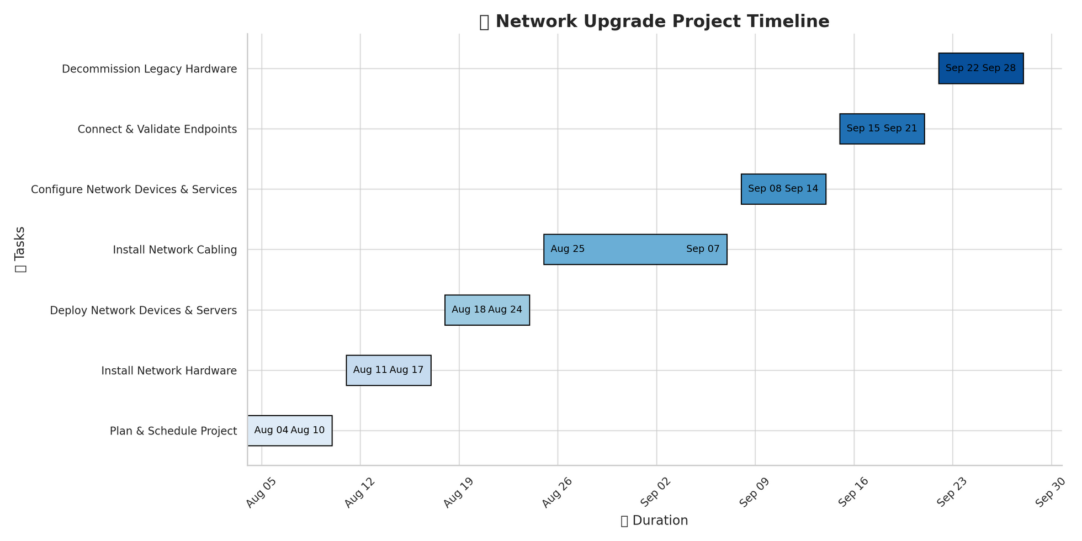
Time Line

Slide 17

Net Tech
Solutions
Thank you
Members of Net Tech - Networking

Slide 18




















































Resource page

